Slide 1
Accessibility and affordability: applying socio-economic, geographical and population service criteria to state, community, private and humanitarian financing of communal water supply and sanitary services
Aziza Baubekova ¹ , Bekmurat Talipov², Aliya Assubayeva² Stefanos Xenarios²
¹ Centre of Preparatory Studies in Nazarbayev University
²Graduate School of Public Policy, Nazarbayev University, Nur-Sultan, Kazakhstan
Webinar organized in the framework of the Programme “Water as a driver of sustainable recovery: economic, institutional and strategic aspects of water resources management in Central Asia’’ , 25 February 2021

Slide 2
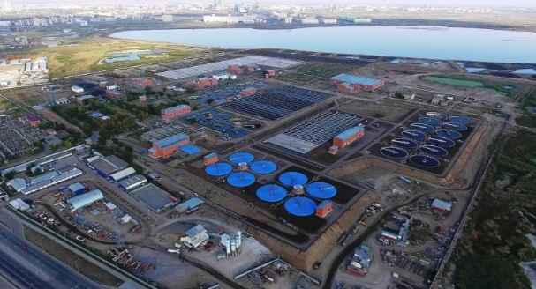
Urban Water and Wasterwater Systems (WWS) and Security Challenges
Uninterrupted operation, continuous upgrading and expansion, network maintenance
Accessibility to disadvantaged regions and affordability to weaker social groups
Operation in weather extremes and economic sustenance in the long run
Water quality to end-uses and environmental status in receiving, discharging bodies

Slide 3
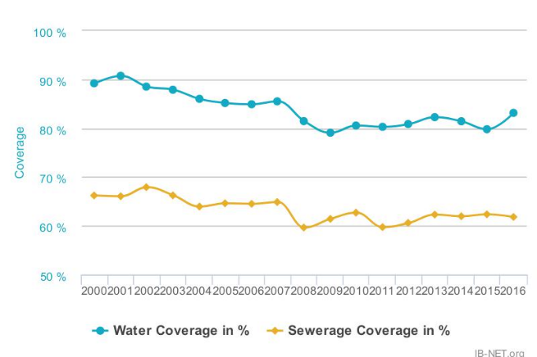
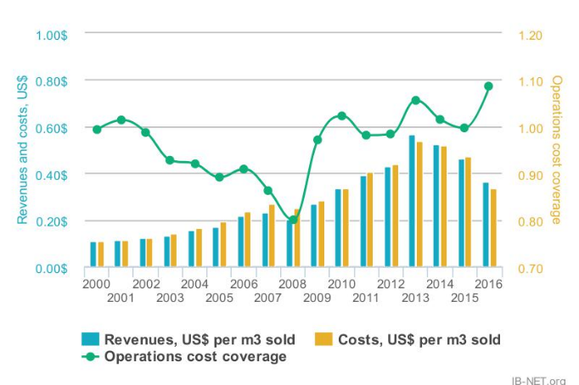
Coverage and C/R ratio overview in Kazakhstan
Notes:
Tariff Differentiation as per scale, operation, technical and environmental features

Slide 4
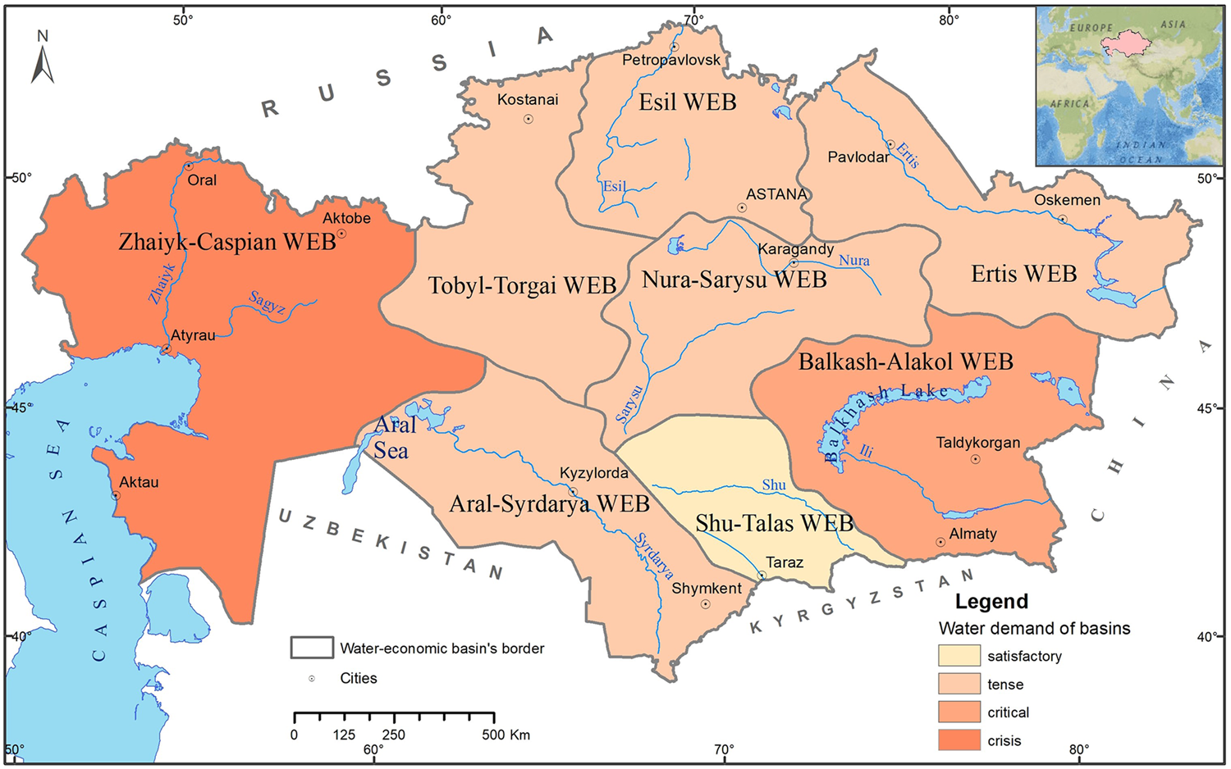
WWS performance and River Basin Management
Source:Issanov et al., 2018
Notes:
WWS through a hydrological basin approach
Water Intake from Surface and Groundwater sources
Water discharge to receiving bodies
Transboundary river basins and pressures
Selection Criteria : geophysical, climatic, scale, technical infrastructure, source and sink connections, data

Slide 5
Preliminary Findings
Main Features of the River Basins in Kazakhstan
River Basins | BA | IR | SD | UC | ST | IS | NS | TT
Area* (km²) | 353,000 | 316,500 | 345,000 | 415,000 | 64,300 | 245,000 | 139,700 | 214,000
Population** (1.02.2019) | 4,039,757 | 2,132,147 | 3,793,564 | 2,158,185 | 980,000* | 2,375,107 | 1,000000* | 1,050,000*
Main rivers* | Ili | Irtysh | Syr Darya | Ural | Shu, Talas, Assa | Ishim | Nura and Sarysu | Tobol, Torgai and Irgiz
Other water bodies* (L=Lakes, R=Reservoir) | Balkhash, Alakol (L) Kapchagai reservoir (R) | Zaisan, Bukhtarma, Oskemen and Shulba (R) | Aral Sea (L) Shardar (R) | Caspian Sea |  |  | Tengiz and Karasor (L) Telekol (R ) | Kushmurun, Sarykopa, Aksuat, Sarymoyin (L)
Water reserves * (km³) | 149.4 | 43.8 | 37.9 | 28 | 6.11 | 5.34 | 4.59 | 2.9
Groundwater resources (km³/yr)**** | 6.9 | 2.3 | 1.6 | 1.2 | 1.6 | 0.2 | 0.8 | 0.4
Water potential**** (km³) | 25.18 | 30.41 | 22.29 | 12.39 | 4.24 | 2.77 | 1.37 | 1.94
Surface water flow (km³/yr)*** | 29.16 | 35.7 | 17.34 | 21.5 | 4.8 | 6.48 | 3.69 | 3.39
Multiyear average surface water flow*** (km³/yr) | 28 | 36.4 | 17.5 | 16 | 4.71 | 2.52 | 1.3 | 2.11
Inflow from adjacent countries*** (km³ yr) | 11.8 | 9.5 | 15.3 | 10.5 | 3.47 | - | 82 from IR Basin | 0.34
Surface flow formed within the basin*** (km³/yr) | 16.2 | 26.9 | 2.14 | 5.47 | 124 | 2.52 | 1.3 | 1.78
Water consumption for municipal needs (km³)**** | 0.27 | 0.13 | 0.1 | 0.12 | 0.03 | 0.12 | 0.09 | 0.04
Water consumption for industry (km³)**** | 0.29 | 2.31 | 0.04 | 1.32 | 0.04 | 0.21 | 1.03 | 0.03
Water consumption for agriculture (km³)**** | 3.48 | 1.41 | 8.7 | 0.1 | 2.83 | 0.02 | 0.08 | 0.02
Water loss during transportation (km³)**** | 0.83 | 0.10 | 1.78 | 0.14 | 0.82 | 0.03 | 0.04 | 0.008
Source: Karatayev et al. 2017, * UNDP 2007 ** NSA 2019 *** MoA RK 2018 ****
Notes:
WWS through a hydrological basin approach
Water Intake from Surface and Groundwater sources
Water discharge to receiving bodies
Transboundary river basins and pressures
Selection Criteria : geophysical, climatic, scale, technical infrastructure, source and sink connections, data

Slide 6
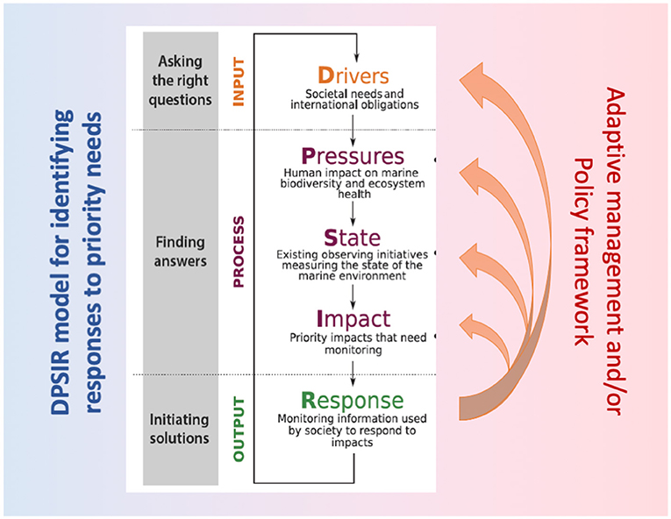
DPSIR Framework on River Basin and WWS Systems (example)
Notes:
WWS through a hydrological basin approach
Water Intake from Surface and Groundwater sources
Water discharge to receiving bodies
Transboundary river basins and pressures
Selection Criteria : geophysical, climatic, scale, technical infrastructure, source and sink connections, data

Slide 7
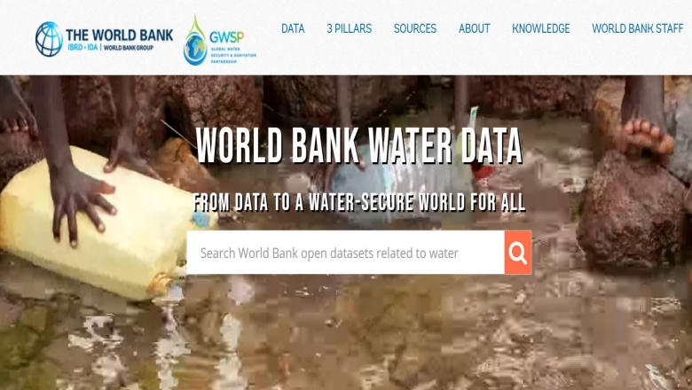
Data Collection
Agency for Strategic planning
and reforms of the
Republic of Kazakhstan
Bureau of National statistics
Water Sources (Freshwater, Groundwater, Coastal)
Collection Network (Gravitational, Pumping, Open, Closed)
Drinking Water Treatment (Processes, Efficiency, Energy)
Wastewater Treatment (Processes, Efficiency, Energy)
Hydrological Balance (Intake, Discharges, Runoffs, Evaporation)
Environmental Performance (Quality, Ecosystems, Climate Change)
Economic Performance (Effectiveness, Financial Sustainability, Property Rights)
Social Cohesion (Social Exclusion, Accessibility, Affordability
Notes:
WWS through a hydrological basin approach
Water Intake from Surface and Groundwater sources
Water discharge to receiving bodies
Transboundary river basins and pressures
Selection Criteria : geophysical, climatic, scale, technical infrastructure, source and sink connections, data

Slide 8
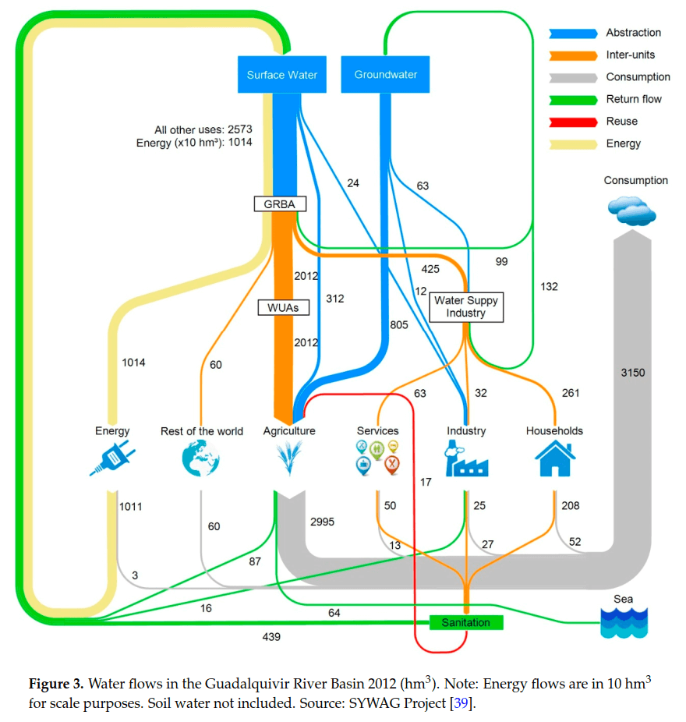
Next Steps : River Basin and Wastewater Systems (example)
DPSIR
DPSIR
DPSIR
Source: http://www.sankey-diagrams.com/tag/water/
Notes:
WWS through a hydrological basin approach
Water Intake from Surface and Groundwater sources
Water discharge to receiving bodies
Transboundary river basins and pressures
Selection Criteria : geophysical, climatic, scale, technical infrastructure, source and sink connections, data

Slide 9
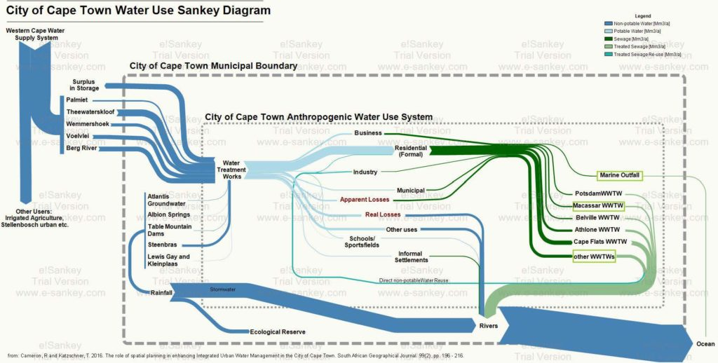
Next Steps : River Basin and Wastewater Systems (example)
DPSIR
DPSIR
DPSIR
DPSIR
DPSIR
Source: http://www.sankey-diagrams.com/cape-town-water-use-sankey-diagram/
Notes:
WWS through a hydrological basin approach
Water Intake from Surface and Groundwater sources
Water discharge to receiving bodies
Transboundary river basins and pressures
Selection Criteria : geophysical, climatic, scale, technical infrastructure, source and sink connections, data

Slide 10
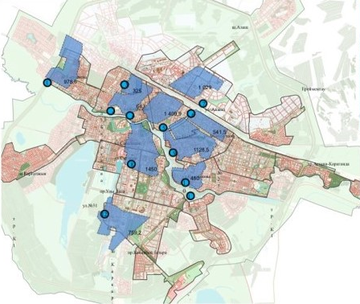
Expected Outcomes
Identify pressures that aggravate operational performance of urban WWS in Kazakhstan
Suggest economic and institutional aspects to sustain financial capability of WWS systems in Kazakhstan
Suggest initiatives to improve capabilities of WWS and offer better accessibility to water users
Propose policies to improve water affordability on WWS services without jeopardizing its financial sustainability

Slide 11
Thank You!

